Slide 1



DEMETRA AI
Revolutionizing Agriculture with Intelligent Weather Insights
PRESENTED BY:
TEAM: POTATO HEADS

Slide 2

Our team
Vasil Vasilev: Software & Coordination
Alexandra Georgieva: Marketing & Design
Krasimir Petkov: Digital Product Creation & Maintenance
Hristo Belchinov: Software
Iraklis Elefteriou: Research & Web Design

Slide 3

The Problem

Slide 4



Current Solutions

Slide 5
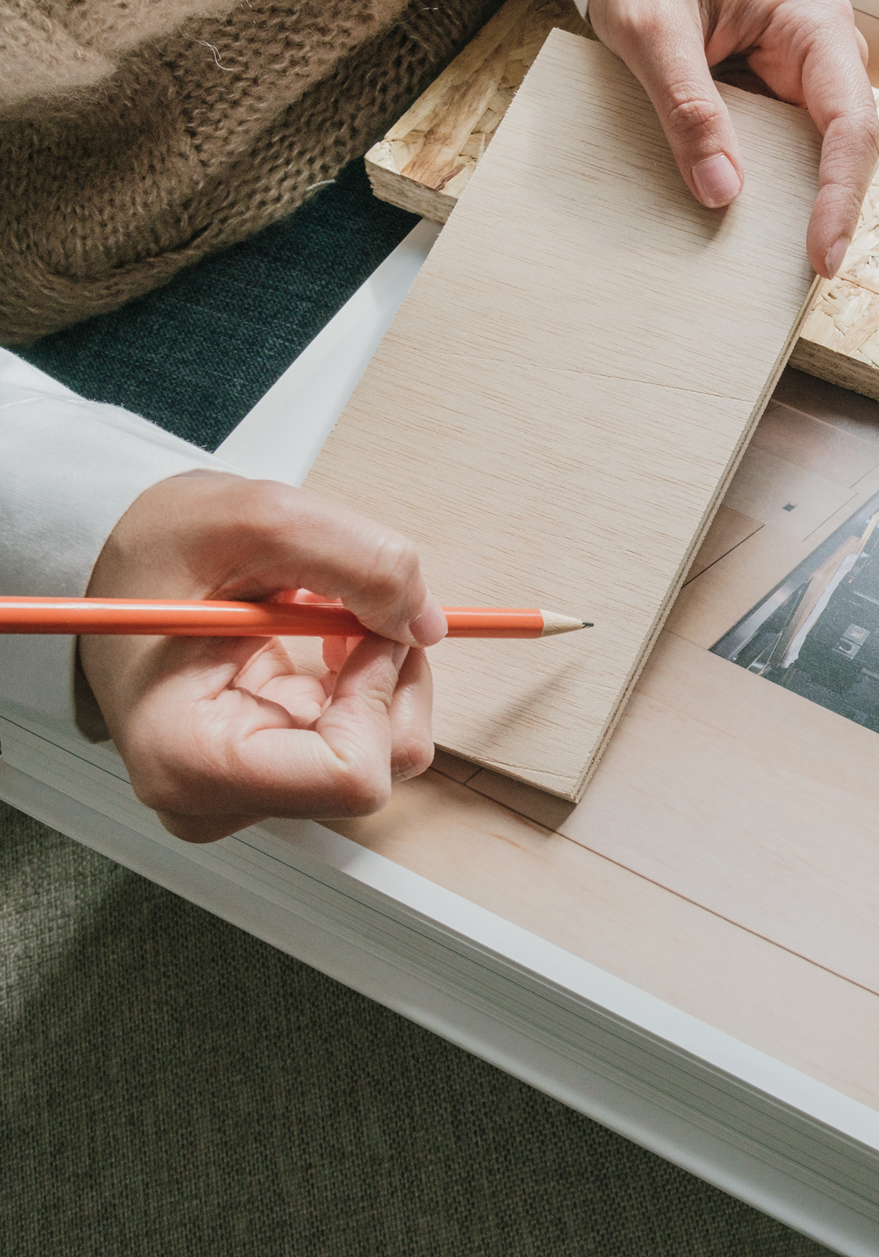
01
Combines real-time weather forecasting with AI-based soil analysis for tailored plans
02
Delivers precise recommendations on crop selection, planting schedules, and resource use
Our Solution
A web application that leverages AI and weather data to create optimized agricultural plans based on forecasts and soil analysis.
03
Integrates multiple data sources for a comprehensive, data-driven farming approach

Slide 6


Our revenue model
Goal # 1
Goal # 2
Freemium & Premium Plans
Partnerships & Collaborations

Slide 7





Slide 8
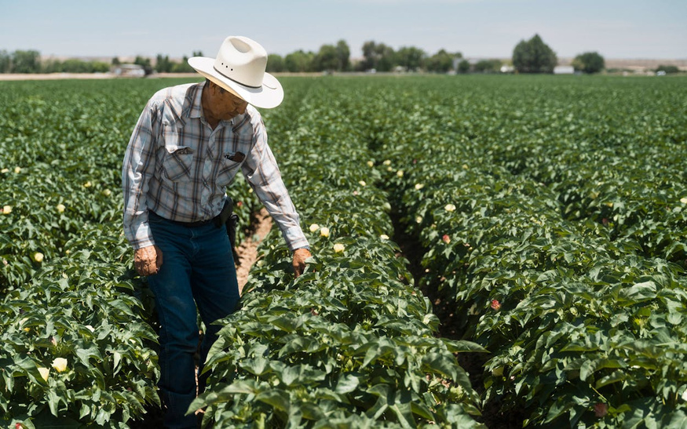

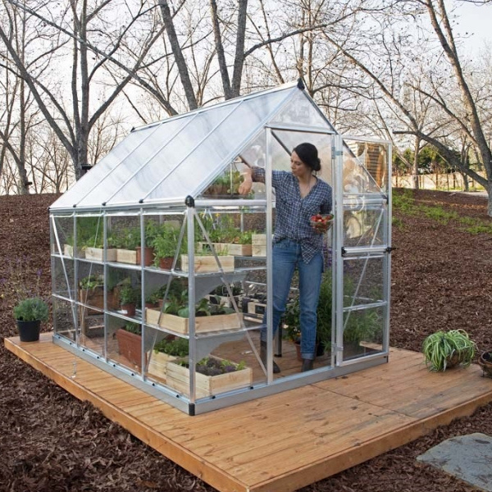
Target Audience

Slide 9
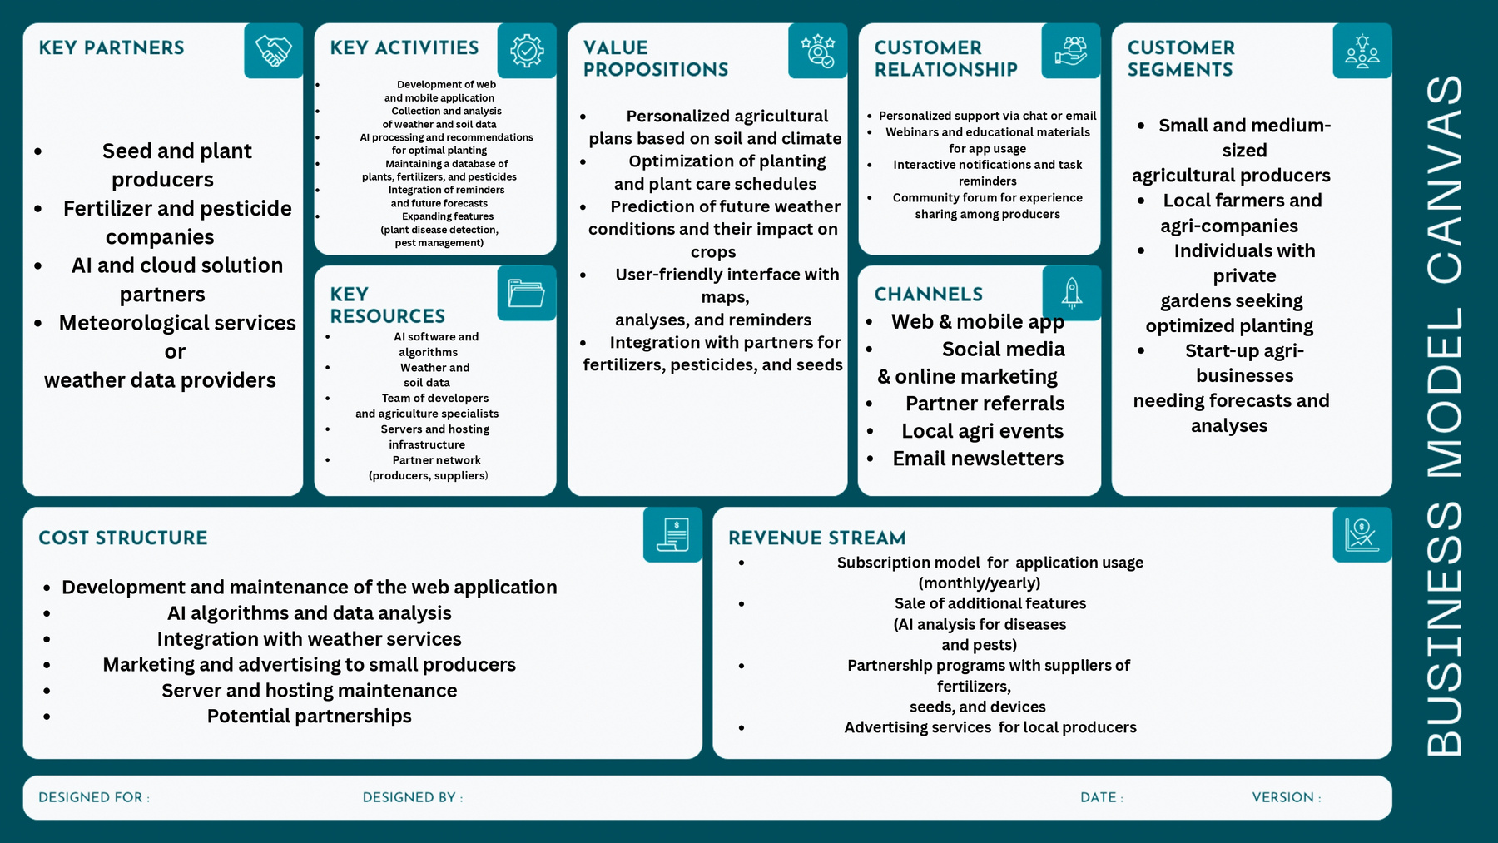

Slide 10
Live Demo

Slide 11
Future Improvements
🔌
Expand data sources with IoT sensor data for enhanced soil and crop monitoring
Develop mobile applications to improve accessibility for farmers in remote areas
Introduce machine learning models to predict pests and diseases early
📱
🤖

Slide 12
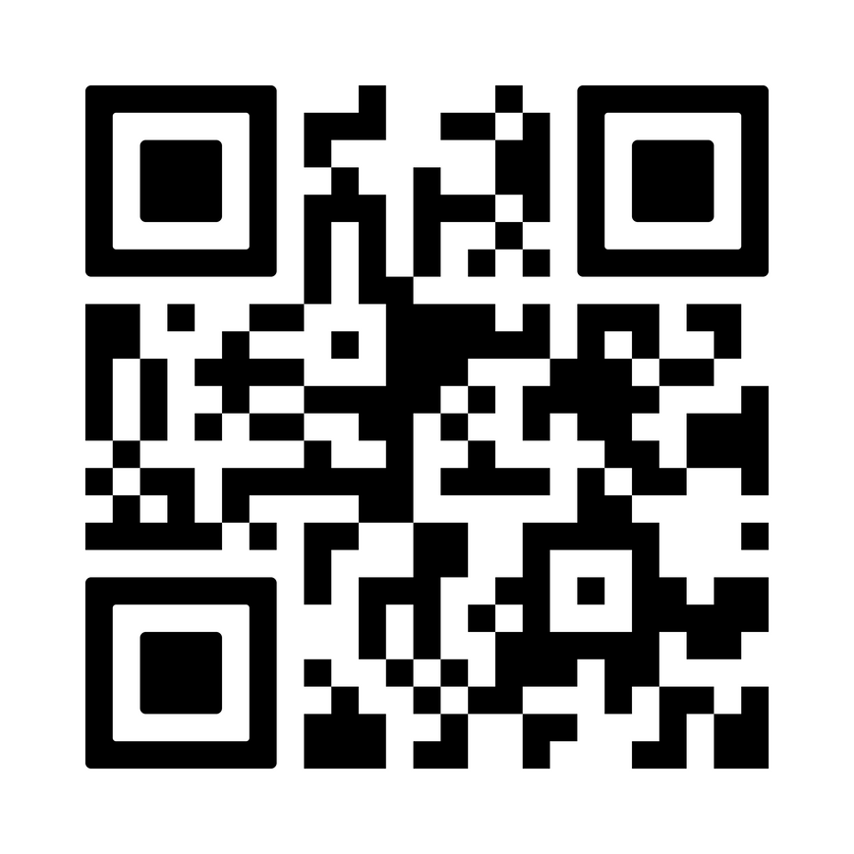
Thank you for your attention!
ANY QUESTIONS?
https://github.com/SookX/Demeter

